Slide 1

DSA-0307 NATURAL LANGUAGE PROCESSING
Building a Finite State Automaton for Token Recognition
GUIDED BY:
Dr.K. ANBAZHAGAN
PRESENTED BY:
K.Mounith(192425090)

Slide 2


Finite State Automaton (FSA)
Step 1: Start from the initial (start) state.
Step 2: Read the input one character at a time.
Step 3: Move to the next state based on the input character.
Step 4: Continue reading all the characters until the input ends.
Step 5: If the final (accept) state is reached, the input is a valid token.
Step 6: If no valid transition is available, the input is rejected.
Step 7: Repeat the same process for the next token.

Slide 3
Token Recognition
Token recognition is the process of identifying meaningful parts of a program.
It is the first step in the lexical analysis phase of a compiler.
The compiler reads the source code one character at a time.
Similar characters are grouped together to form a token.
Each token is given a token type.
Finite State Automaton (FSA) is used to recognize tokens quickly and correctly.

Slide 4
Introduction
Finite State Automaton (FSA) is a model used to recognize patterns in text.
It is mainly used in the lexical analysis phase of a compiler.
Token recognition means identifying words and symbols in a program.
An FSA reads the input one character at a time.
If the final state is reached, the input is accepted as a valid token.
It recognizes tokens like keywords, identifiers, numbers, operators, and symbols.
FSA makes token recognition fast, simple, and accurate

Slide 5
OBJECTIVES
To understand the concept of Finite State Automaton (FSA).
To recognize different tokens from the source code.
To identify keywords, identifiers, numbers, operators, and separators.
To design an FSA for token recognition.
To improve the speed and accuracy of lexical analysis.
To reduce errors while recognizing tokens.
To understand how an FSA works in compiler design.
To build a simple and efficient token recognition system.

Slide 6
PPROBLEM STATEMENT
A program contains many words and symbols.
The compiler must identify each word and symbol correctly.
Finding tokens manually takes more time and may cause errors.
Invalid characters should be detected easily.
The system should recognize tokens quickly and correctly.
A Finite State Automaton (FSA) is used to identify valid tokens.
The main goal is to make token recognition fast, simple, and accurate.

Slide 7
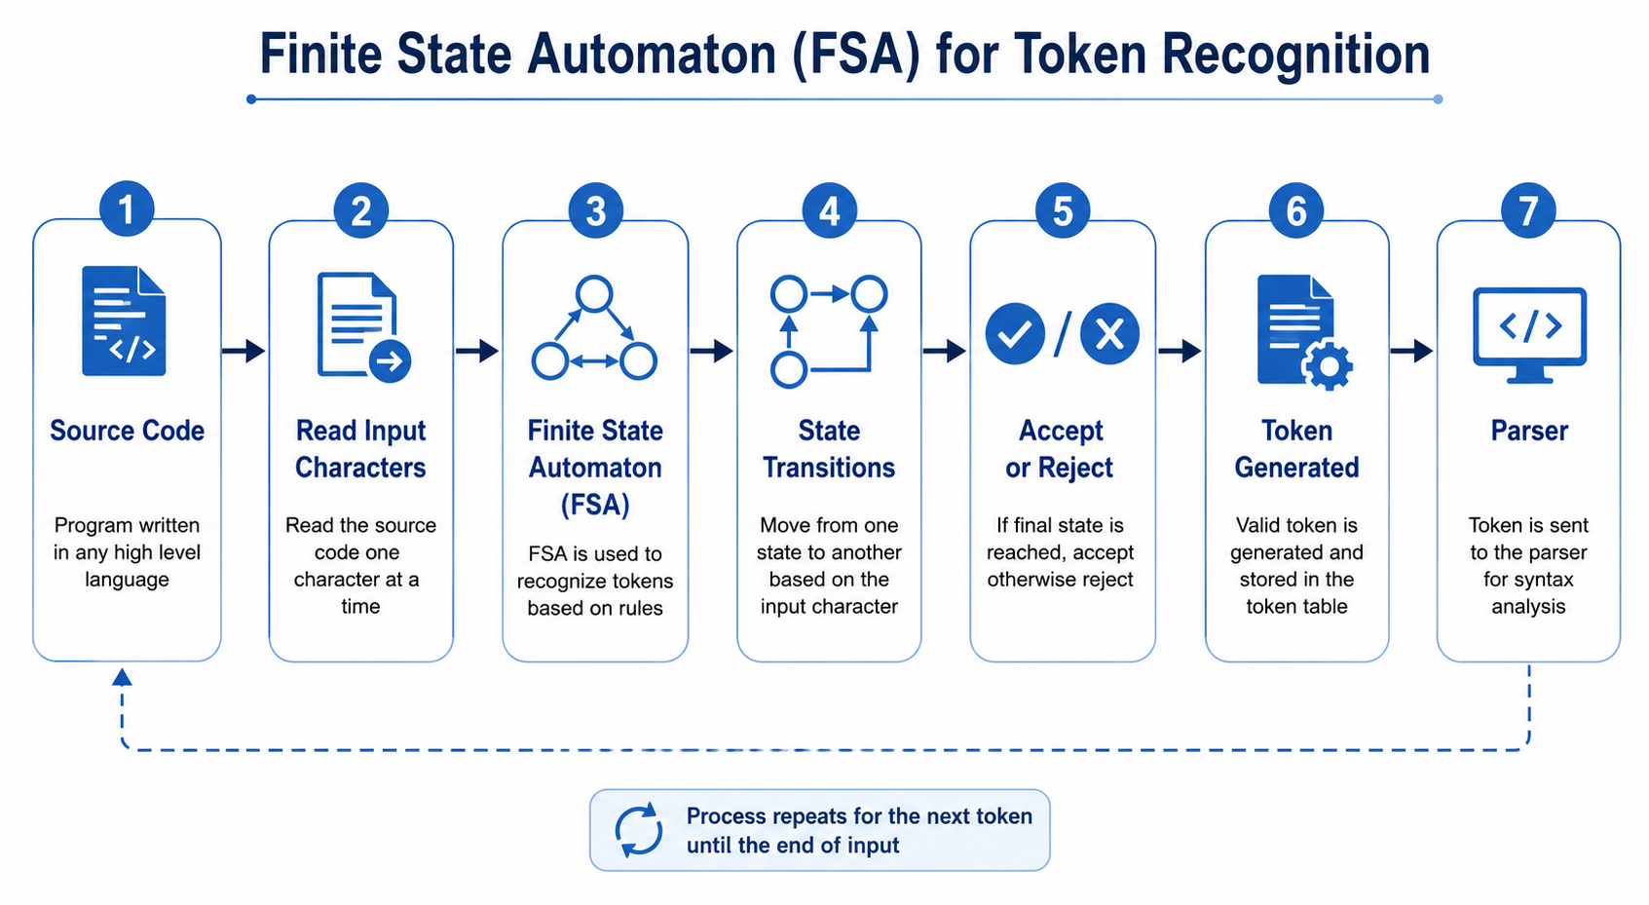
WORK FLOW

Slide 8
APPLICATIONS
Compiler Design – Recognizes tokens during lexical analysis.
Pattern Matching – Finds words or patterns in text.
Spell Checking – Detects valid and invalid words.
Text Search – Used in search engines to find keywords.
Network Protocols – Controls communication between devices.
Digital Circuit Design – Used in sequential circuits and controllers.
Input Validation – Checks valid user input such as email IDs and phone numbers.
Software Development – Used in parsers, interpreters, and programming language tools.

Slide 9
FUTURE SCOPE
Improve the speed of token recognition.
Support more programming languages.
Recognize complex tokens more accurately.
Handle larger source code efficiently.
Reduce errors during lexical analysis.
Integrate with modern compiler tools.
Use AI techniques for smarter token recognition.
Develop faster and more efficient lexical analyzers.

Slide 10
CONCLUSION
Finite State Automaton (FSA) is an efficient method for token recognition.
It reads the source code one character at a time.
It recognizes tokens such as keywords, identifiers, numbers, operators, and separators.
It makes lexical analysis fast, simple, and accurate.
It helps improve the overall performance of a compiler.
FSA is an important concept in compiler design and is widely used in lexical analyzers.

Slide 11


